Slide 1
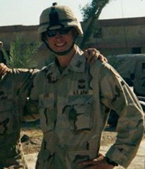
Camp CPT Joshua T. Byers Reno “City Camp” 3-5 May 2021
JCLC 2021
Cadet Brief
Captain Joshua Byers

Slide 2
Agenda
What is JCLC
Where are we going
Who is coming
What will we do
What can I earn
How can I sign up

Slide 3
What is JCLC
JROTC Cadet Leadership Camp (JCLC)
Army JROTC annual requirement
Opportunity to practice leadership in an unfamiliar environment
Experience interacting and training with Cadets from other schools in a military setting
Provide “hands-on” experiential learning through adventure training
Learn while having fun!

Slide 4
Where are we going
Reno “City Camp” - adopted this year only, to meet Covid restrictions
Reno Fire Department training tower, North Valleys - Rappelling
Peavine or Galena Creek Park – Land Nav
Spanish Springs HS – Raider Challenge Course

Slide 5
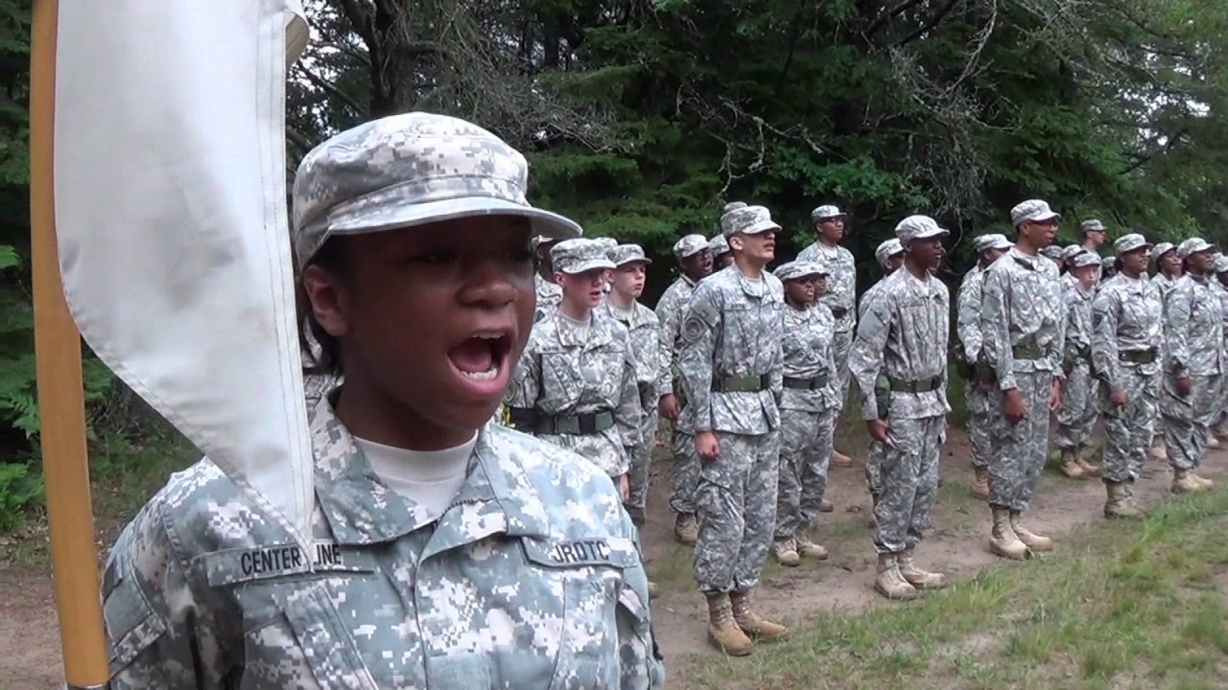
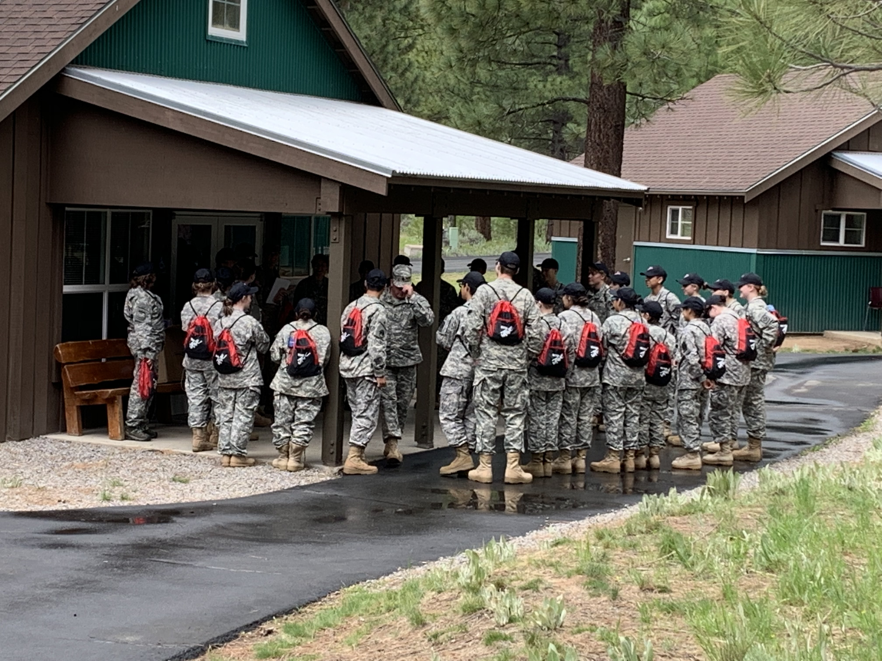
Who is Coming
20 Cadets from each of the 11 WCSD JROTC Units
20 WCSD JROTC Instructors
3 Army National Guard Medics

Slide 6
What will we do (JCLC Requirements 2021)
Mandatory Events
– Rappelling / Land Navigation / Graduation Ceremony (at schools)
Integrated Events
– Evaluated leadership positions (by school) / Drill & Ceremony / Personal Hygiene (Covid protocols)
Optional Events
– Rope Bridge & First Aid (Raider Challenge)

Slide 7
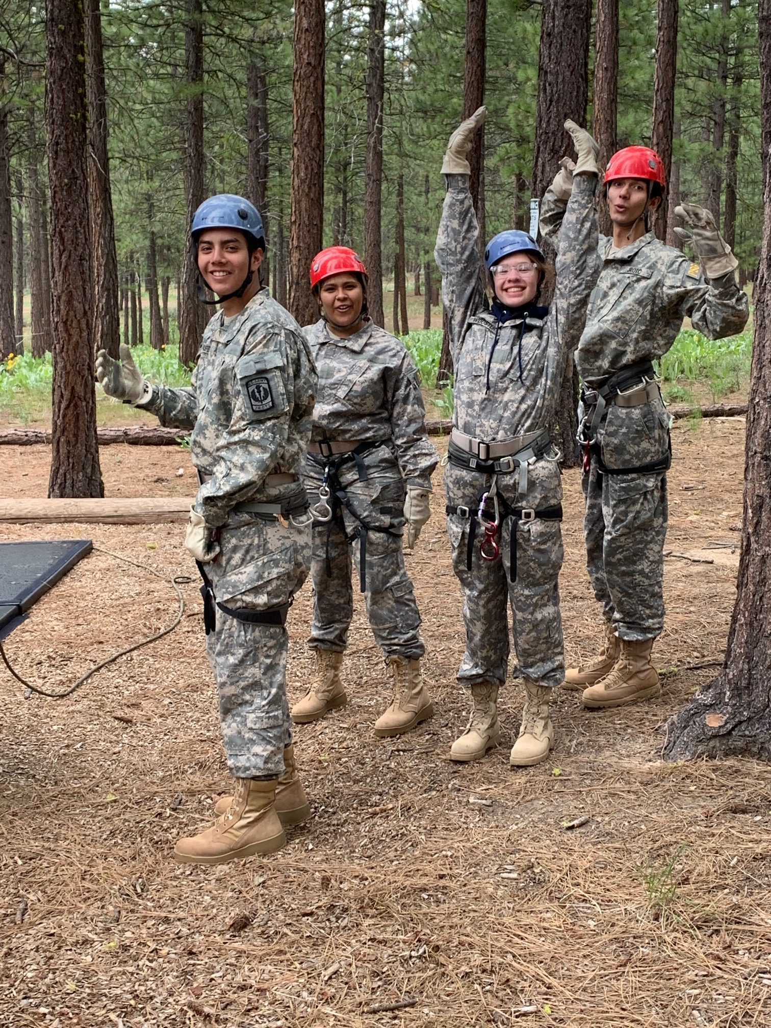
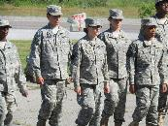
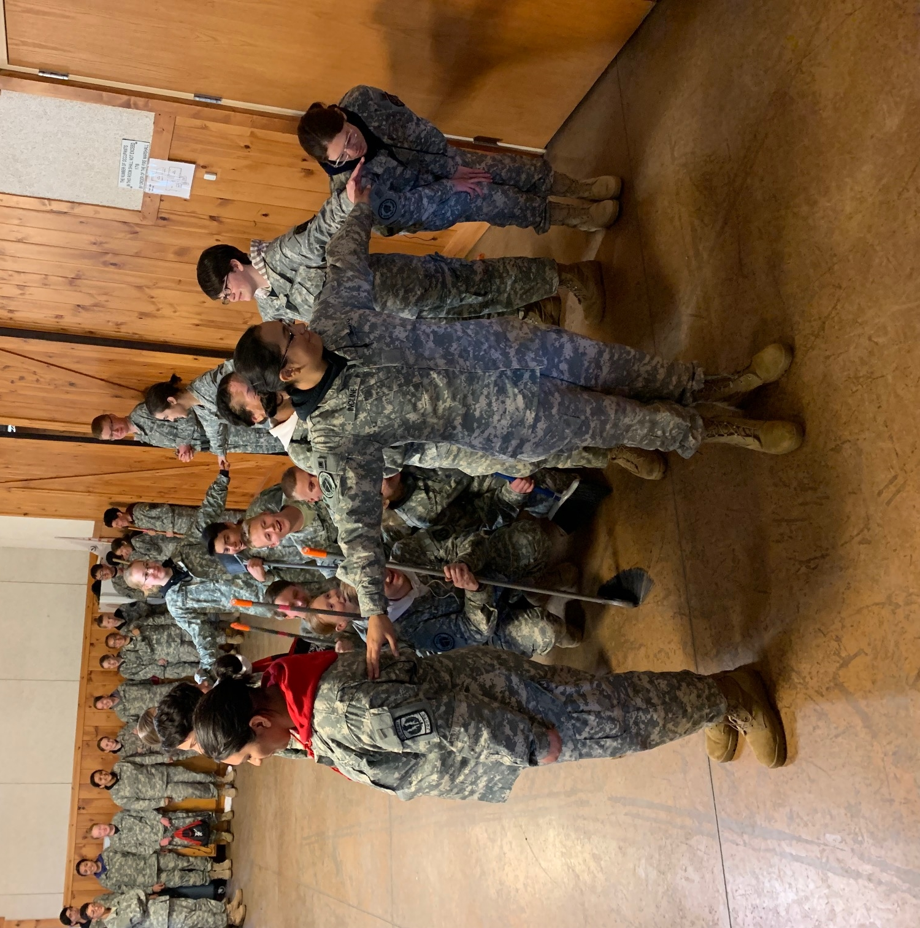
What will we do
Cadets will form 6 companies of approximately 40 Cadets each (2 platoons of 20, maintaining school integrity for Covid restrictions)
Each platoon will have an Instructor from their respective schools who will establish and evaluate daily leadership positions at the platoon level only.
Cadet Chain of Command will ensure that the platoon is organized, informed and prepared to train daily (uniform & equipment, personal hygiene, chow etc)
Cadet leaders will be evaluated using a “Blue Card” system.

Slide 8
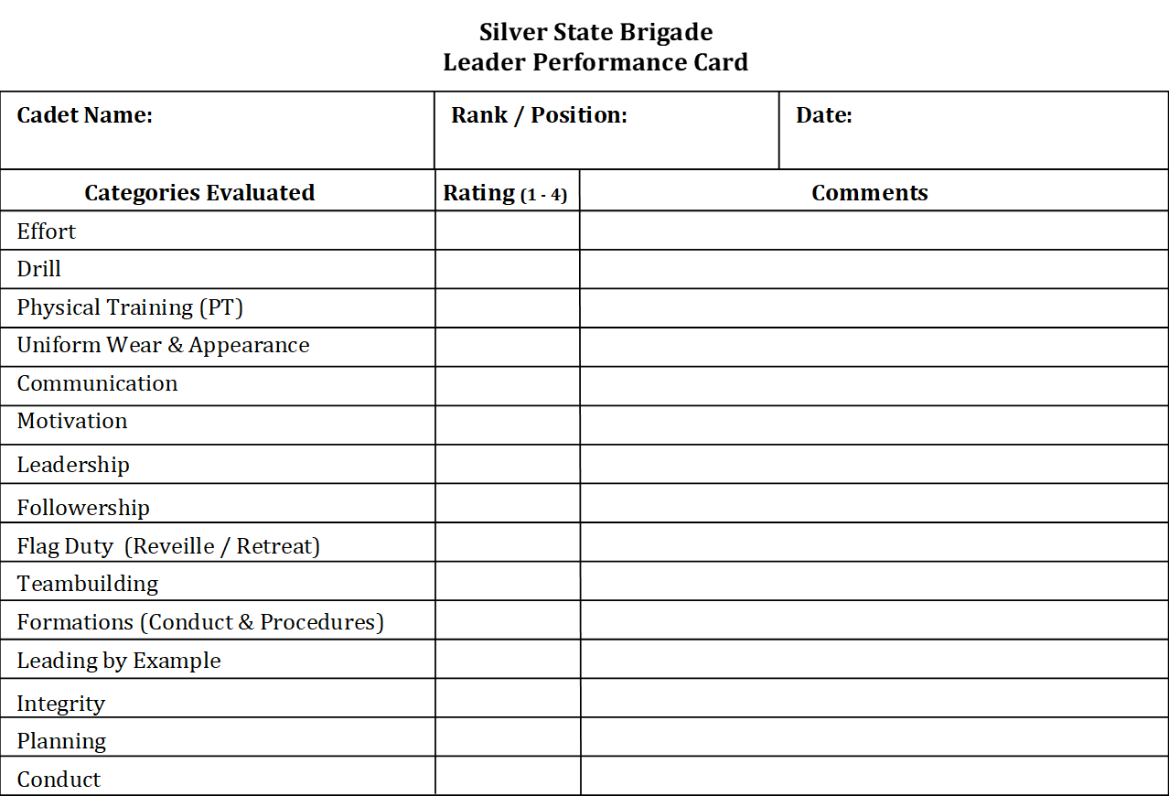
What will we do
Blue Card (front)

Slide 9
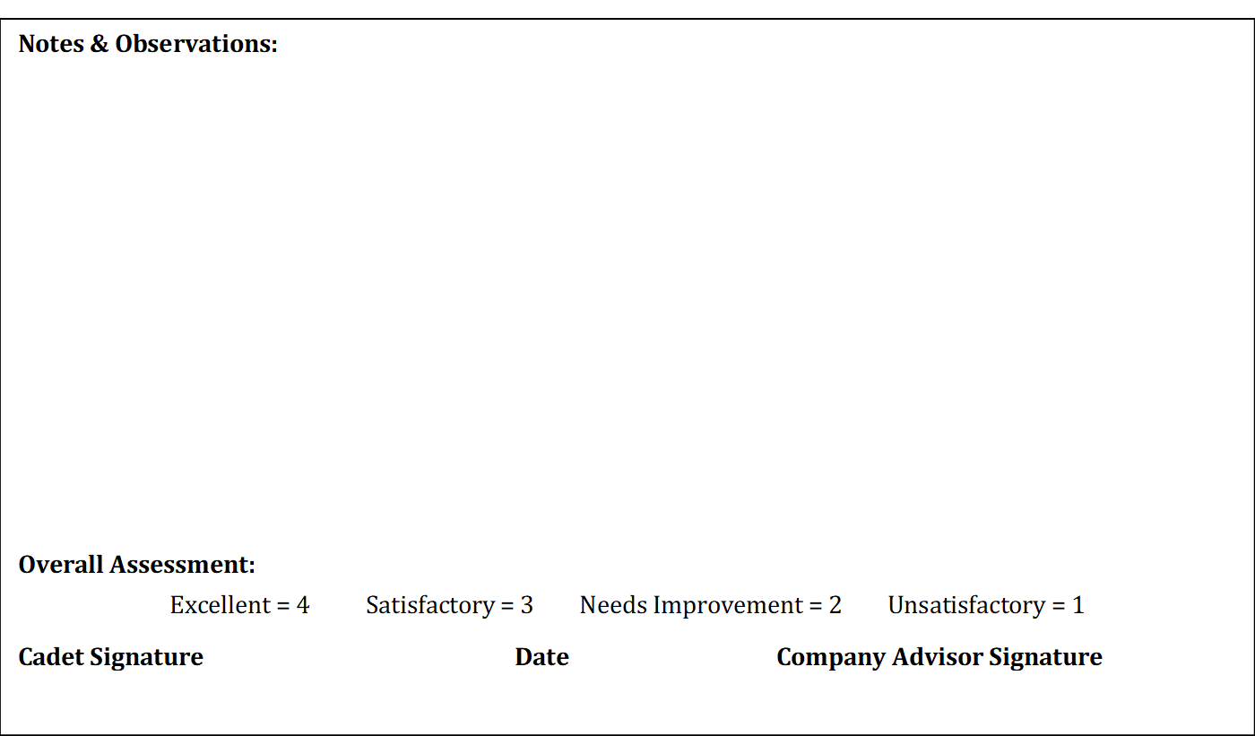
What will we do
Blue Card (back)

Slide 10
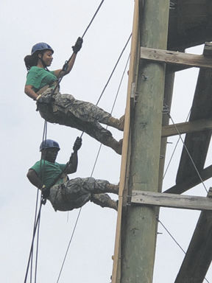
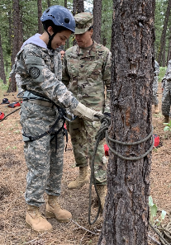
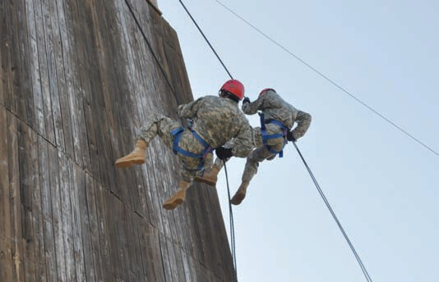
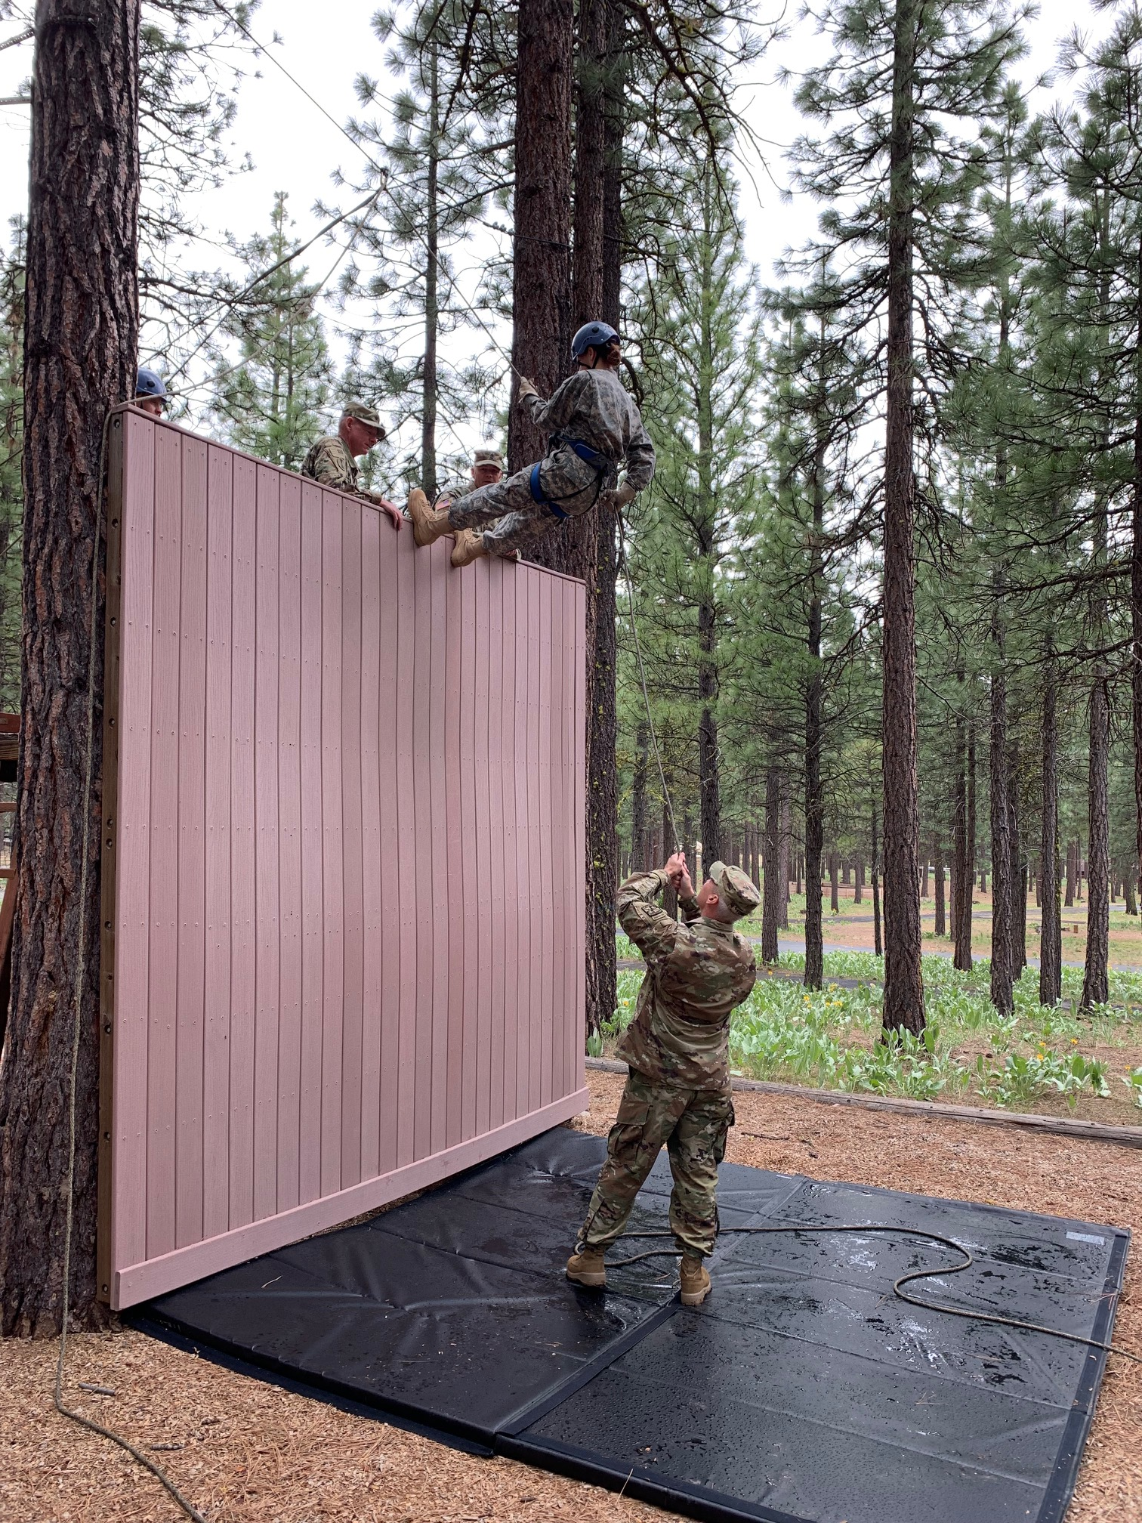
What will we do
Day 1
Travel to Reno Fire Dept
Conduct rappelling ground training
Conduct rappelling
Sack lunch on site

Slide 11
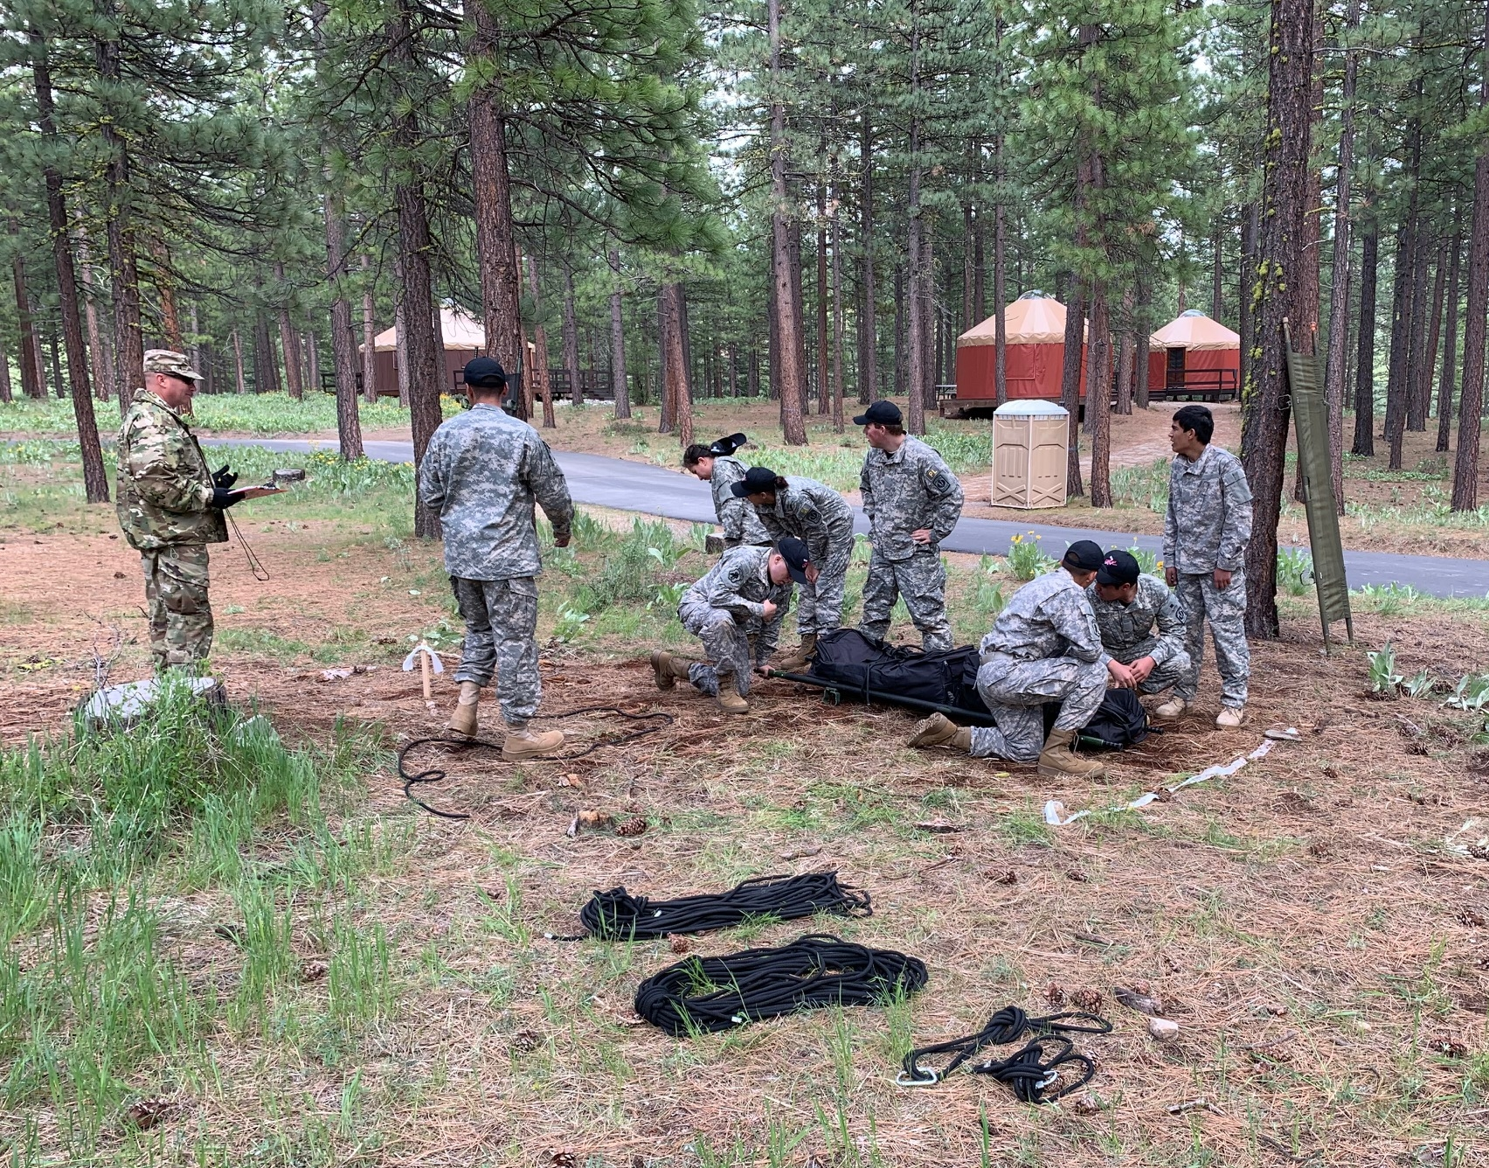
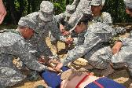
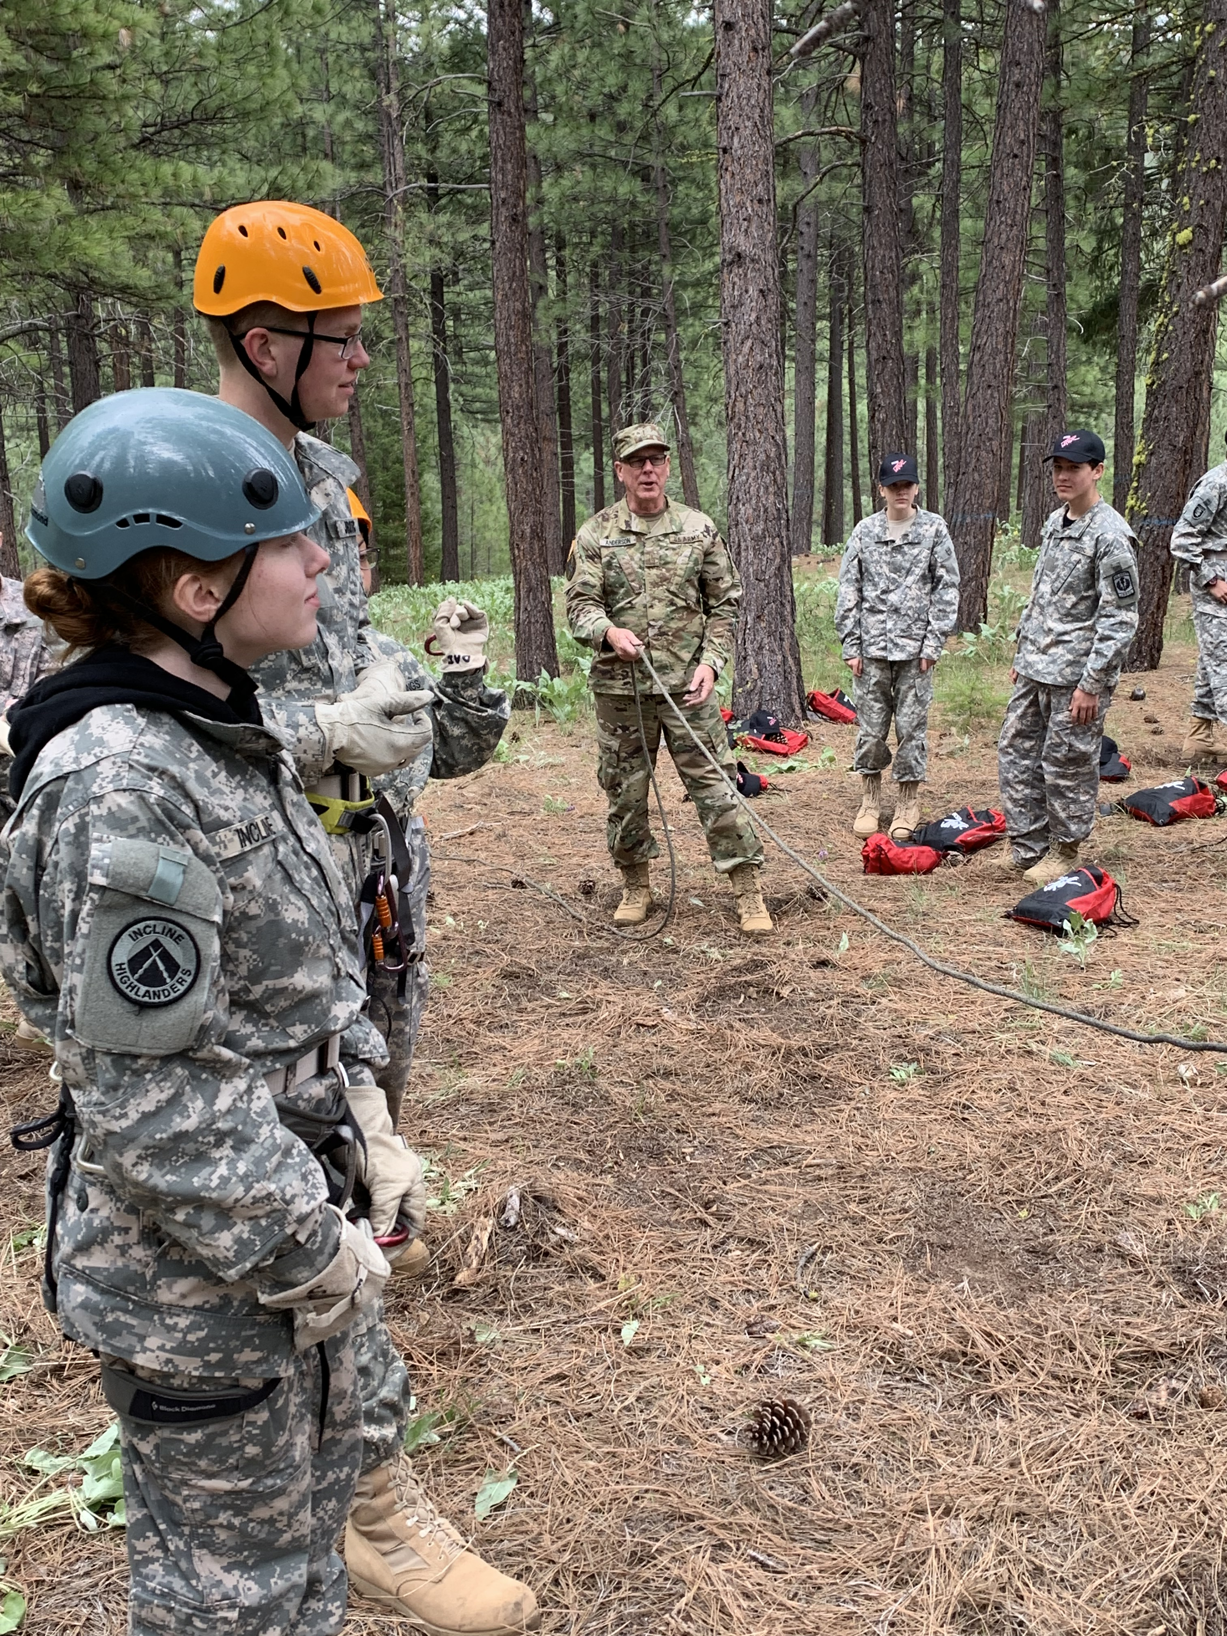
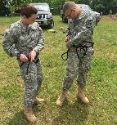
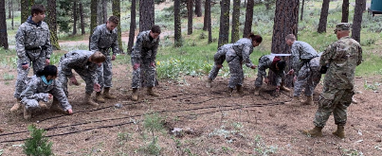
What will we do
Day 2
Travel to Spanish Springs HS
Conduct Rope bridge, Swiss seat, first aid training
Orientation to Raider Challenge completion events
Sack lunch on site
Cross Country Rescue
Rope Bridge
First Aid
Swiss Seat
Rope Bridge

Slide 12
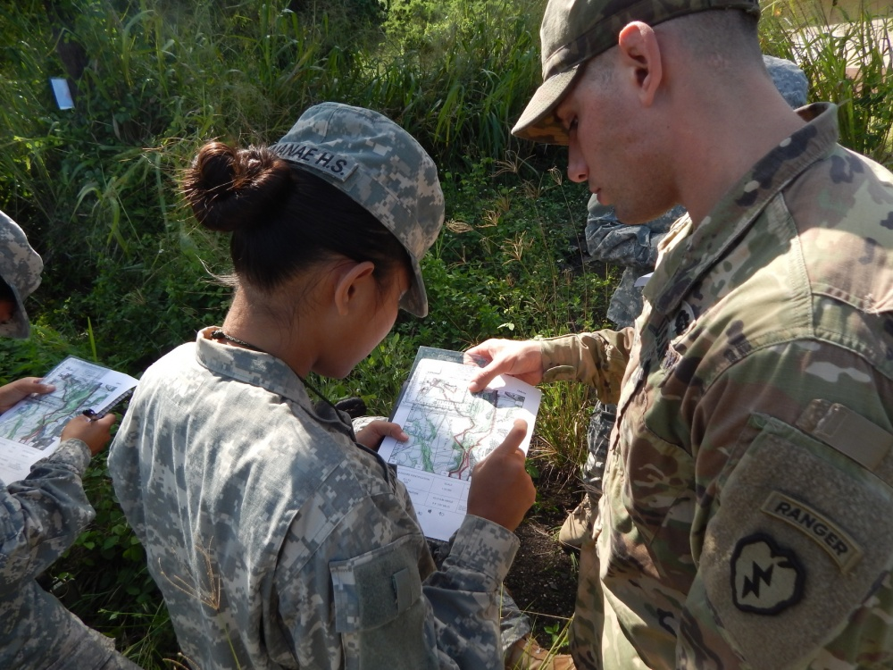
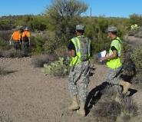
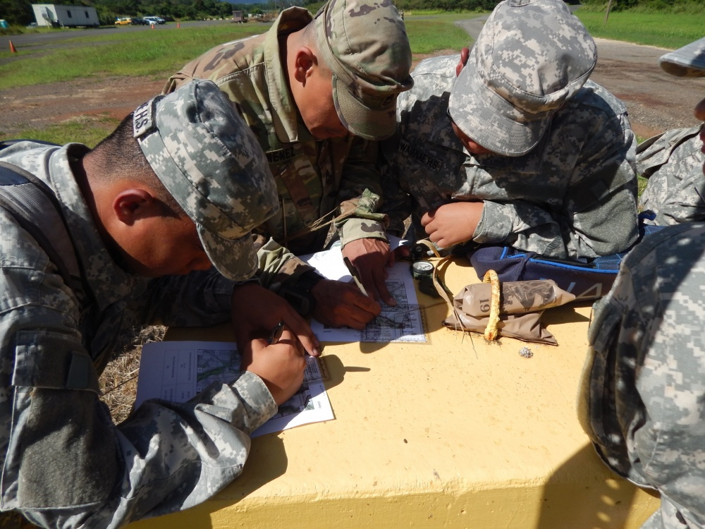
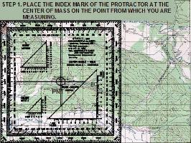
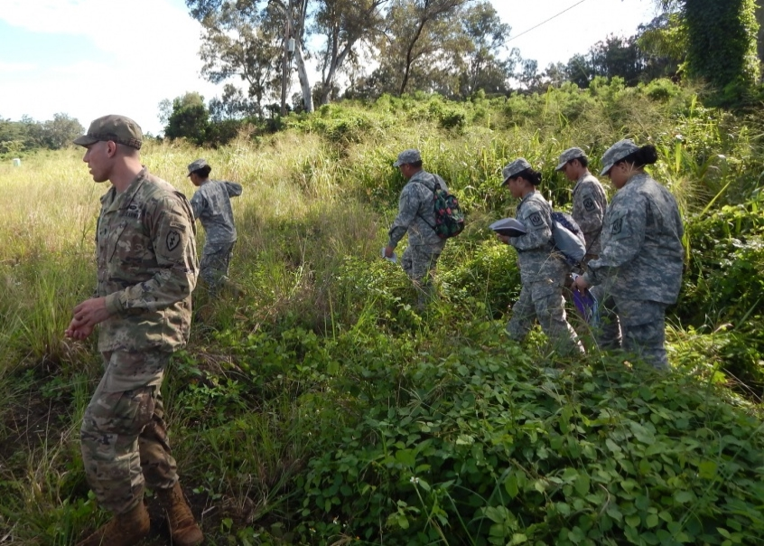
What will we do
Day 3
Travel to Land Nav site (TBD-Stead; Peavine; Galena Creek Park)
Conduct course orientation
Conduct compass/land nav course (in groups)
Sack lunch on site

Slide 13
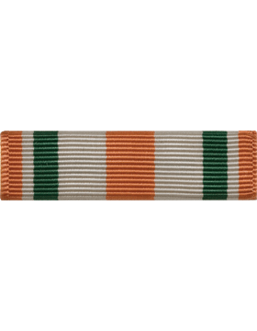
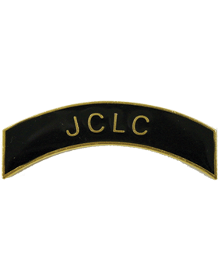
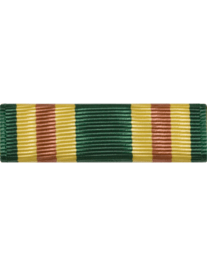
What can I earn
JCLC Completion Ribbon (N-3-11) and Arc
Best Cadet in the Platoon Ribbon
(TBD)
Orienteering Arc & Ribbon
JCLC Certificate of Completion

Slide 14
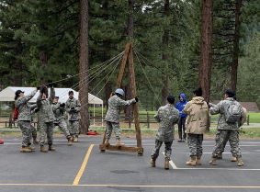
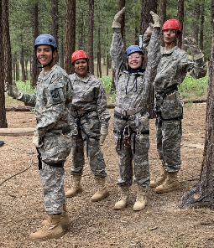
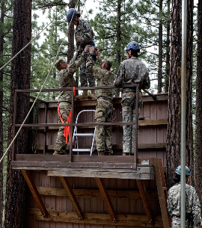
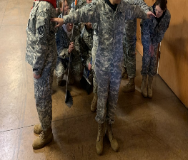
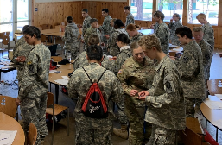
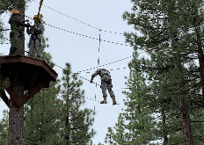
How do I sign up
See your JROTC Instructor as soon as possible!

